Slide 1
Lecture 11: Information Theory
Today: introduction to information theory, Morse code analysis, information content of a message
Lab: Analyzing information content of text from different sources
Wednesday: determining authorship

Slide 2
Claude Shannon (1916–2001)
Born in Petoskey, Michigan
Completed two undergraduate degrees at the University of Michigan
Master’s thesis in electrical engineering on binary arithmetic revolutionized electrical engineering and formed the basic of digital circuit design
PhD thesis: “An Algebra for Theoretical Genetics”
Involved in code breaking during World War 2
Shannon (+ robotic mouse)

Slide 3
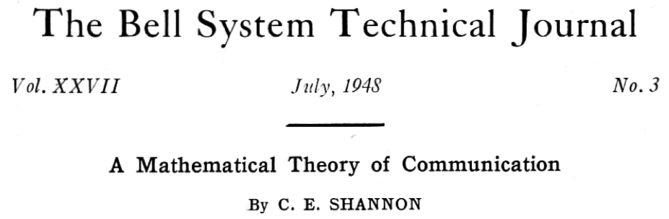
Shannon’s paper

Slide 4
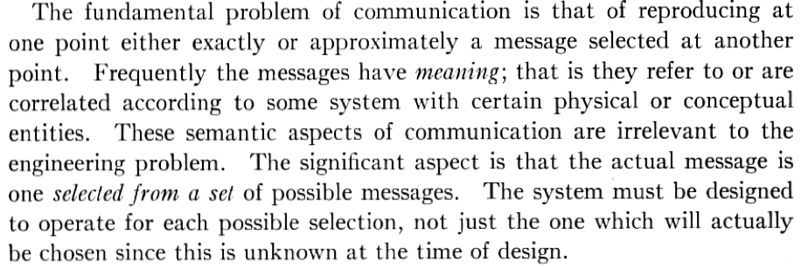
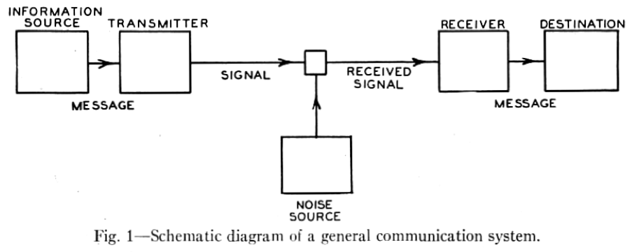
Mathematical theory of communication

Slide 5
Messages take many forms
There are many ways to communicate
Messages take many different forms
Audio
English
French
Mandarin
Arabic
Visual
Sign language
…
Electronic
…

Slide 6

Binary
Paper also chooses to specifically measure information in terms of binary digits
First use of the word “bit”, which is now ubiquitous (e.g. smartphone download speeds quoted in Mbit/s, etc.)
Binary is highly practical for digital electronic circuitry

Slide 7

Binary from Python
>>> for i in range(17):
... print "Decimal: {0:02d} Binary: {0:05b}".format(i,i)
...
Decimal: 00 Binary: 00000
Decimal: 01 Binary: 00001
Decimal: 02 Binary: 00010
Decimal: 03 Binary: 00011
Decimal: 04 Binary: 00100
Decimal: 05 Binary: 00101
Decimal: 06 Binary: 00110
Decimal: 07 Binary: 00111
Decimal: 08 Binary: 01000
Decimal: 09 Binary: 01001
Decimal: 10 Binary: 01010
Decimal: 11 Binary: 01011
Decimal: 12 Binary: 01100
Decimal: 13 Binary: 01101
Decimal: 14 Binary: 01110
Decimal: 15 Binary: 01111
Decimal: 16 Binary: 10000
Tiles in Maxwell Dworkin restroom

Slide 8
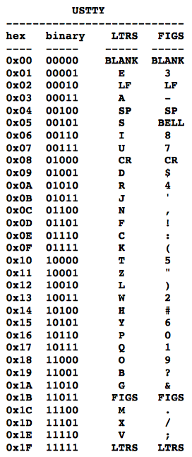
Teletype
Originated in early twentieth century for sending messages of text electronically
Could also be used to archive text

Slide 9
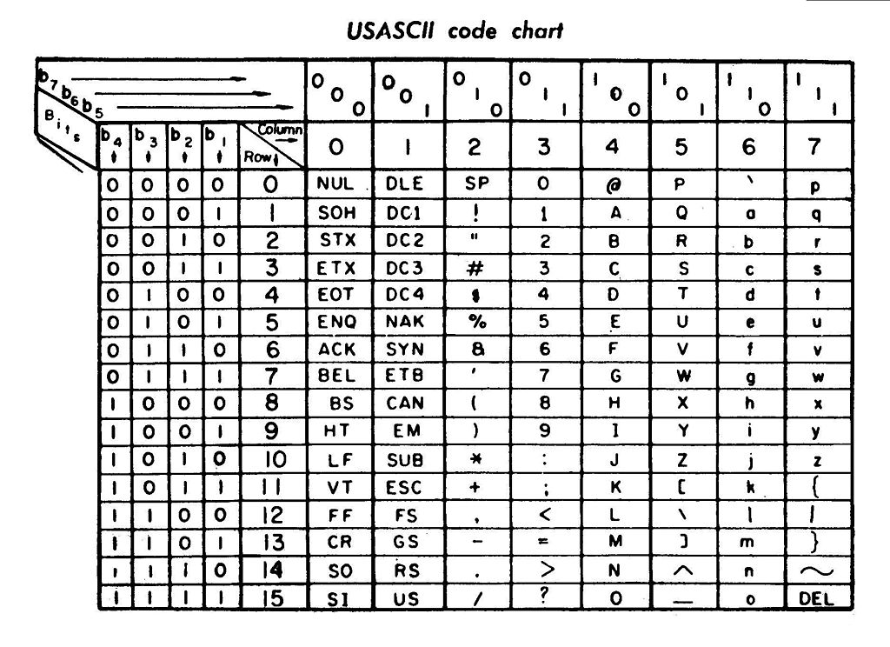
ASCII
American Standard Code for Information Interchange
Developed from teleprinter codes
7 bits of information: 2⁷ = 128 combinations
First commercial usage in 1963
Lyndon Johnson mandates that all computers purchased by the government support ASCII
Leads to near-universal adoption
Code for “q”: 1110001
2⁶+2⁵+2⁴+2⁰ = 64+32+16+1 = 113

Slide 10
Your computer knows ASCII
Python 2.7.5 (default, Aug 25 2013, 00:04:04)
[GCC 4.2.1 Compatible Apple LLVM 5.0 (clang-500.0.68)] on darwin
Type "help", "copyright", "credits" or "license" for more information.
>>> print ord("q")
113
>>> for a in ("C","h","r","i","s"):
... print ord(a)
...
67
104
114
105
115
>>> print chr(113)
q
Notes:
Python has two commands to convert characters of text to and from ASCII. The ord command returns the ASCII code of a character. The chr command converts a character to ASCII. Note that the value of 113 for “q” matches that given in the table on the previous slide.

Slide 11
Unicode
Further extensions such as UTF-8, UTF-16, UTF-32 offer near-universal support for international characters (even for languages with large numbers of characters like Chinese)

Slide 12
Bit rate
Shannon introduces a channel transmission rate C, expressed in terms of bits/time
Teletype printer in video prints approximately five characters per second
Each character contains five bits of information
C = 25 bits/second

Slide 13
Bit rate
Alternative method of calculation: how many possible messages in second?
In t seconds,
Channel capacity
Can this be applied to other codes?

Slide 14
Morse code
Developed in 1836 by artist Samuel Morse, physicist Joseph Henry, and inventor Alfred Vail for sending messages on a telegraph system
Still in use today
Experienced users can achieve speeds of 40 words per minute

Slide 15
Morse code design: letter frequencies
Letter frequencies
Most common letters have short codes
E 11.28%, T 8.46%, A 7.52%, I 7.52%, N 7.52%, O 7.52%, H 6.02%, R 5.83%, D 4.14%, L 3.76%, U 3.20%, C 2.82%, M 2.82%, F 2.35%, W 1.88%, Y 1.88%, G 1.60%, P 1.60%, B 1.50%, V 1.13%, K 0.75%, Q 0.47%, J 0.38%, X 0.38%, Z 0.19%
E
T
A
I
N
O
H
·
-
·-
··
-·
---
····

Slide 16
Timing specifics
Dot = line closure for one unit of time and then line open for one unit of time
Dash = line closure for three units of time and line open for one unit of time
Letter Space = line open for three units of time
Word Space = line open for six units of time
Additional Rule: cannot have two successive spaces

Slide 17
Possible signals
Dot = 2 time units
Dash = 4 time units
Dot-space = 5 time units
Dash-space = 7 time units
Dot-wordspace = 8 time units
Dash-wordspace = 10 time units

Slide 18
Total number of signals transmitted in unit time
Let N(t) be the number of signals that can form in time t
N(t) = number of signals ending in a “dot”
number of signals ending in a “dash”
number of signals ending in a “dash-space”
number of signals ending in a “dot-space”
number of signals ending in a “dot-wordspace”
number of signals ending in a “dash-wordspace”
“Difference equation”

Slide 19
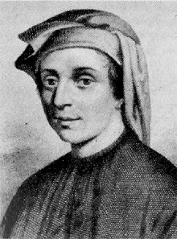
Aside: Fibonacci difference equation
Sequence of numbers where each is the sum of the previous two
Mathematically, let F(n) be the nth Fibonacci number
Try solution
1,1,2,3,5,8,13,21,34,55,89,…
Fibonacci
(c. 1170 – c. 1250)

Slide 20
Aside: Fibonacci difference equation
Hence x satisfies a quadratic
Two solutions
Define the Golden ratio as , and then

Slide 21
Aside: Fibonacci difference equation
General solution will be a linear combination
Using F(1) = F(2) = 1 gives particular solution
At large n,

Slide 22
Returning to the problem
Try solution of the form N(t) = x^{t}
Writing gives
Largest value of x and smallest value of

Slide 23
Data rate for Morse code
Hence for large t
Shannon’s data transmission rate
Hence

Slide 24
Information content
How much information is coded by the information source?
The distribution of letters in English is not uniform: “E” is more common than “Q”, “TH” is more common than “QZ”
This means that the information source (if the source is speaking words of English) does not just choose random sequences of dots and dashes

Slide 25
Acronyms
2moro - Tomorrow
2nite - Tonight
BRB - Be Right Back
BTW - By The Way -or- Bring The Wheelchair
B4N - Bye For Now
BCNU - Be Seeing You
BFF - Best Friends Forever -or- Best Friend's Funeral
CYA - Cover Your Ass -or- See Ya
DBEYR - Don't Believe Everything You Read
DILLIGAS - Do I Look Like I Give A Sh**
FUD - Fear, Uncertainty, and Disinformation
FWIW - For What It's Worth -or- Forgot Where I Was
GR8 - Great
ILY - I Love You
IMHO - In My Humble Opinion
IRL - In Real Life
ISO - In Search Of
J/K - Just Kidding
L8R - Later
LMAO - Laughing My Ass Off
LOL - Laughing Out Loud -or- Lots Of Love -or- Living On Lipitor
LYLAS - Love You Like A Sister
MHOTY - My Hat's Off To You
NIMBY - Not In My Back Yard
NP - No Problem -or- Nosy Parents
NUB - New person to a site or game
OIC - Oh, I See
OMG - Oh My God
OT - Off Topic
POV - Point Of View
RBTL - Read Between The Lines
ROTFLMAO - Rolling On The Floor Laughing My Ass Off
RT - Real Time -or- ReTweet
THX or TX or THKS - Thanks
SH - Sh** Happens
SITD - Still In The Dark
SOL - Sh** Out of Luck -or- Sooner Or Later
STBY - Sucks To Be You
SWAK - Sealed (or Sent) With A Kiss
TFH - Thread From Hell
RTM or RTFM - Read The Manual -or- Read The F***ing Manual
TLC - Tender Loving Care
TMI - Too Much Information
TTYL - Talk To You Later -or- Type To You Later
TYVM - Thank You Very Much
VBG - Very Big Grin
WEG - Wicked Evil Grin
WTF - What The F***
WYWH - Wish You Were Here
XOXO - Hugs and Kisses

Slide 26
Partial information quiz
To see a world in a grain of sand
The five boxing wizards jump quickly
H_r_a_d _n_v_r_i_y
W_l_ d_n_ i_ b_t_e_ t_a_ w_l_ s_i_

Slide 27
Partial information quiz
To see a world in a grain of sand
William Blake
The five boxing wizards jump quickly
Pangram
Harvard University
Well done is better than well said
Benjamin Franklin

Slide 28
Interlude: text game

Slide 29
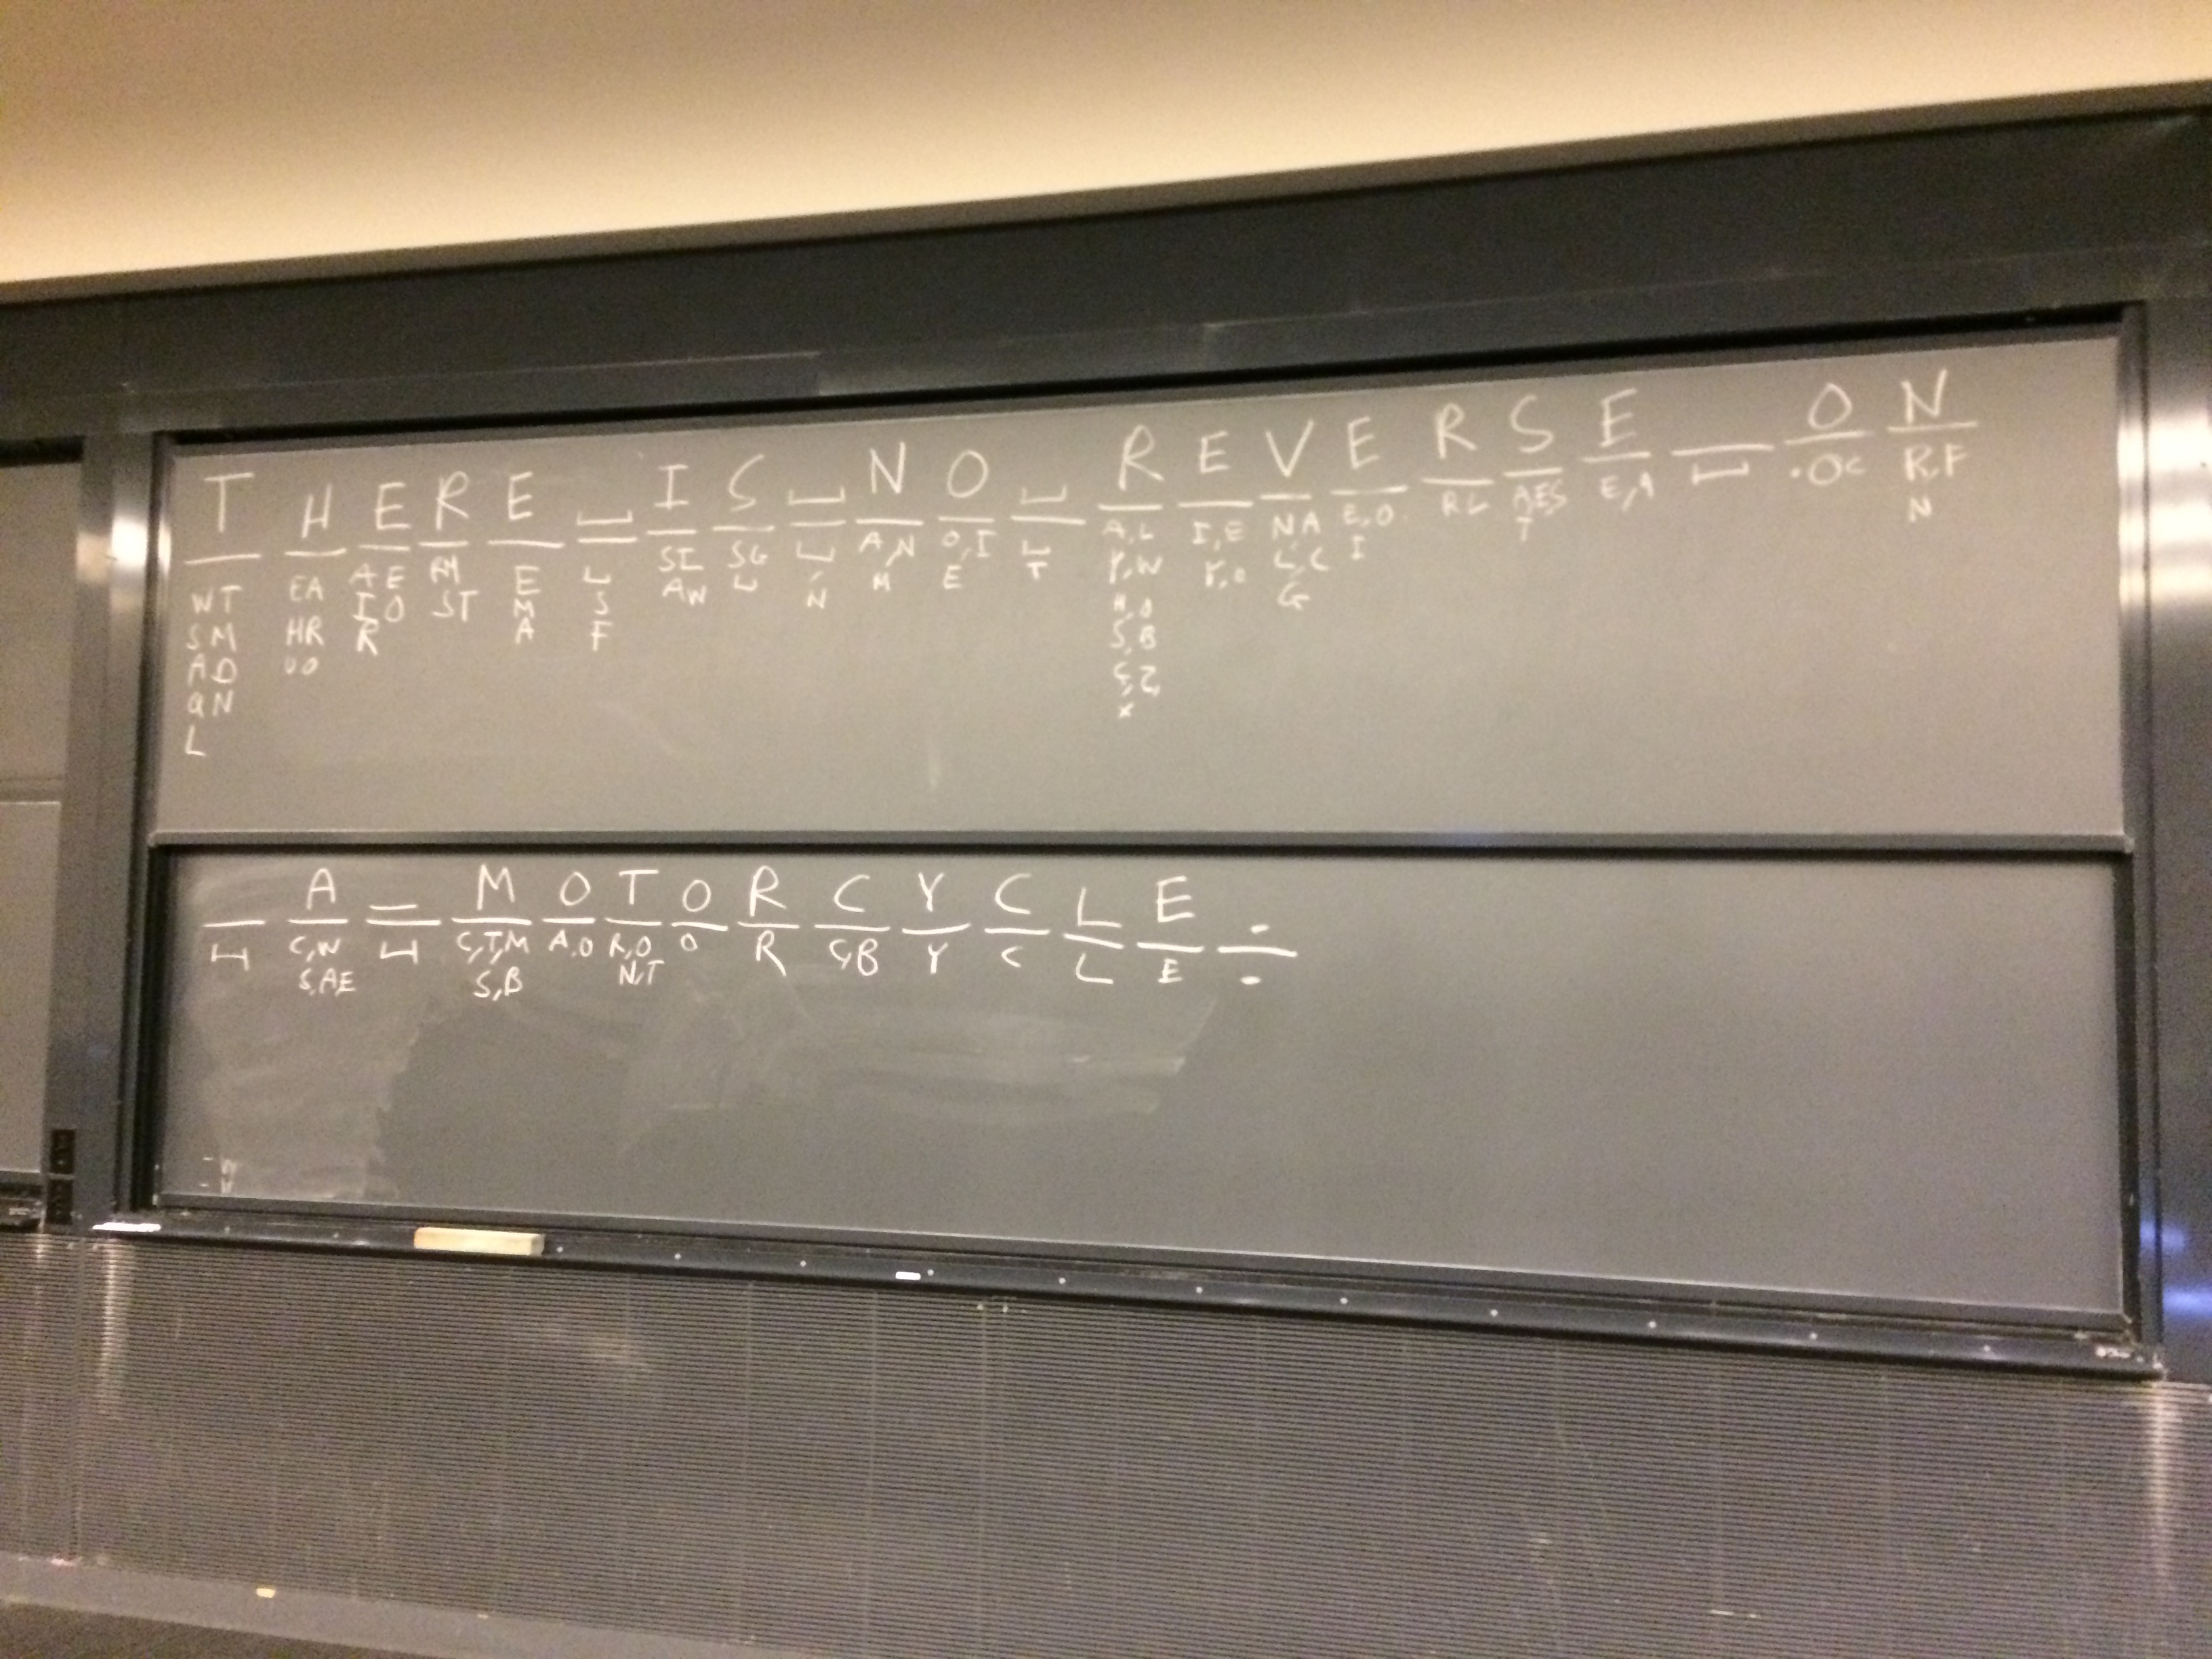
Notes:
Each letter of a mystery text message was revealed one-by-one. Before each letter was revealed, plausible guesses were listed. The number of plausible guesses varies dramatically. The most information about the message is revealed when there were many guesses.

Slide 30
Shannon’s key idea
A discrete information source is characterized by the probabilities for emitting signals from the source

Slide 31
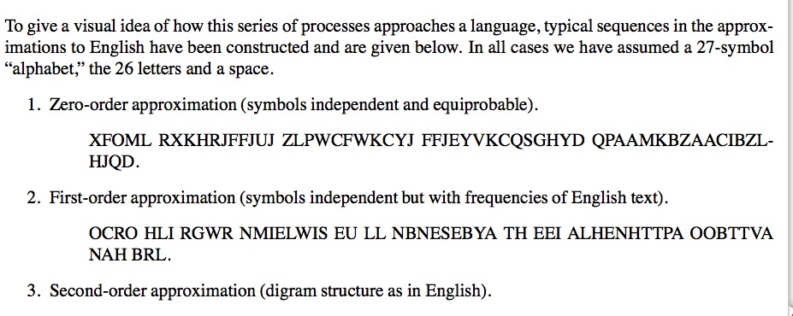
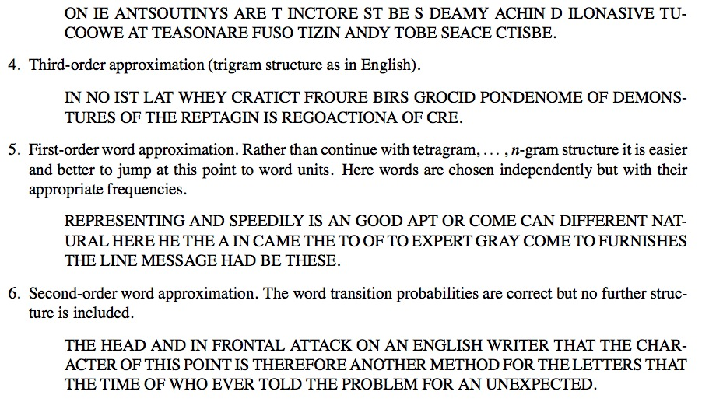

Slide 32
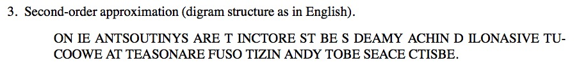

How to simulate the digram structure

Slide 33
Information content
Numbers in 0 to 63, such as 47=101111, need six bits of information
If the numbers are equally probable, then being told the number has information content
Each binary digit has one bit of information content
Adapted from Information Theory by Iain Murray, http://www.inf.ed.ac.uk/teaching/courses/it/

Slide 34
Guess a number from 0 to 63
Is the number 36? a1=No
Is the number 42? a2=No
Is the number 47? a3=Yes
Total information: 0.0227+0.0231+5.9532 = 6 bits
Adapted from Information Theory by Iain Murray, http://www.inf.ed.ac.uk/teaching/courses/it/

Slide 35
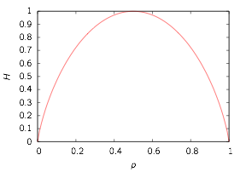
Shannon entropy
Source has syllables with probabilities p1, p2, …, pn
Shannon entropy: average information content of a source
Example: unfair coin p1 = p, p2 = 1–p
Makes sense:
H=0 if p=0 or p=1 as we gain no information
H is maximum if p=0.5 as it’s the most uncertain case

Slide 36
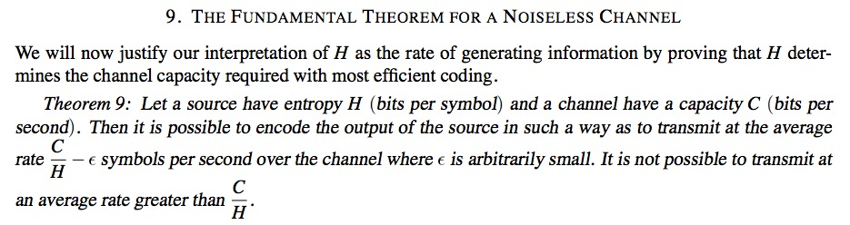
Shannon’s fundamental theorem
Suppose the information source has entropy H and the channel has capacity C
One can encode the output of the source to that it can be transmitted a rate of up to C/H symbols per second
It is not possible to transmit faster than C/H

Slide 37
Dictionary example
Input program
Output
# List recap
a=[1,2,6,4]
print a[1]
# Modify the list and print it
a[3]=10
print a
print
# Initialize a dictionary
b={'alice':67,'bob':32}
print b['alice']
# Add another dictionary element
b['charlie']=12
print b
# Print the keys of the dictionary
print b.keys()
print
# Loop using keys and values
for c,d in b.iteritems():
print c,d
2
[1, 2, 6, 10]
67
{'charlie': 12, 'bob': 32, 'alice': 67}
['charlie', 'bob', 'alice']
charlie 12
bob 32
alice 67
Notes:
In a list, the entries are indexed by integers starting from zero. A dictionary is a more general data structure, where its entries can be indexed by any string. This a very similar to the organization of a physical dictionary.
Example: dict.py

Slide 38
Counting frequencies
Input program
Output
# String of text
a='She sells sea shells on the sea shore'
# Split elements into a list
b=a.split(' ')
# Count the words
c={}
for w in b:
if(w in c):
# Add 1 to existing counter
c[w]+=1
else:
# New counter
c[w]=1
# Print frequencies
for w,f in c.iteritems():
print w,f
on 1
shells 1
shore 1
She 1
sea 2
sells 1
the 1
Notes:
Dictionaries are very useful for counting frequencies of words in text. Here, a string of text is broken into words, and then the frequencies of each word is counted in a dictionary. Note that “She”, “she”, or “she!” would all be stored as different keys—Python does not make any attempt to recognize these as the same word.
Example: d_count.py

Slide 39
Regular expression example
Input program
Output
# Import regular expression functions
import re
# Create test list
a=["cat","dog","bear","bird"]
# Create pattern to match "a" character
p=re.compile("a")
# Print elements in list that match
for x in a:
if(p.search(x)):
print x
# Create pattern to match "b" or "d"
p2=re.compile("[bd]")
# Print elements in list that match
print
for x in a:
if(p2.search(x)):
print x
cat
bear
dog
bear
bird
Notes:
Regular expressions are a general and very flexible way to process and transform strings of text. While the details may differ slightly, regular expressions are found in many programming languages and tools, and are not unique to Python. In the first example here, elements in a list with an “a” are found. In the second example, elements with either a “b” or “d” are found.
Example: reg_exp.py

Slide 40
Regular expression example
Input program
Output
# Import regular expression functions
import re
# Pattern to match color names
p=re.compile("(green|red|blue)")
# Test string
s="The primary colors are red, green, and blue."
# Change all matches
print p.sub("color",s)
# Only change the first match
print p.sub("color",s,count=1)
# Second test string
t="You can't touch this!"
# Pattern to remove punctuation
p2=re.compile("[!,'\.]")
# Apply it
print p2.sub("",t).lower()
The primary colors are color, color, and color.
The primary colors are color, green, and blue.
you cant touch this
Notes:
Regular expressions can be used to substitute some text in a string for something else. The can either apply to multiple times to the string (as in the first output line) or just to the first occurrence (as in the second output line). In the context of word analysis, regular expressions can be used to strip out punctuation. The string command “lower()” can also be used, to convert a string to lower case.
Example: reg_exp2.py

Slide 41
This week’s lab
Measure information content in a text:
Determine frequency distribution of a words in a text
Check that the distribution obeys Zipf’s law (frequency of a word is inversely proportional to its rank in the frequency table)
Compute the entropy of the frequency distribution

